Slide 1


Smart Mobility Engineering Lab (ISE3231)
Week _ Lecture
ISE Department Prof. Mehdi Pirahandeh
School of Global Convergence Studies

Slide 2

Navigation
1
School of Global Convergence Studies

Slide 3
Goals
____
____
____
School of Global Convergence Studies

Slide 4
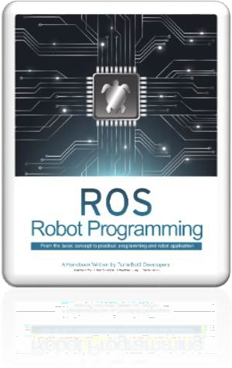
Contents
Run Navigation Node
Estimate Initial Pose
Set Navigation Goal and Tuning Guide
School of Global Convergence Studies

Slide 5
I. Run Navigation Node

Slide 6
Run Navigation Node
Run roscore from Remote PC
ubuntu@ubuntu:~$ roscore
Open a new terminal and Connect to Raspberry Pi with its IP address. The default password is `turtlebot`
ubuntu@ubuntu:~$ ssh ubuntu@RASPBERRY_PI_IP_ADDRESS
ubuntu@ubuntu:~$ export TURTLEBOT3_MODEL=burger
ubuntu@ubuntu:~$ roslaunch turtlebot3_bringup turtlebot3_robot.launch
Open a new terminal and launch the Navigation node
ubuntu@ubuntu:~$ export TURTLEBOT3_MODEL=burger
ubuntu@ubuntu:~$ roslaunch turtlebot3_navigation turtlebot3_navigation.launch map_file:$HOME/map.yaml
*** To save TURTLEBOT3_MODEL parameter
ubuntu@ubuntu:~$ echo “export TURTLEBOT3_MODEL=burger” >> ~/.bashrc
School of Global Convergence Studies

Slide 7
II. Estimate Initial Pose

Slide 8

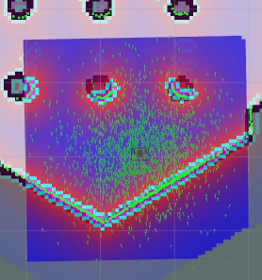
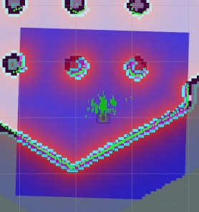
Estimate Initial Pose
Initial Pose Estimation must be performed before running the Navigation as this processs initializes the AMCL parameters that are critical in Navigation. TurtleBot3 has to be correctly located on the map with the LDS sensor data that nearly overlaps the displayed map.
Click the 2D Pose Estimate button in the Rviz menu.
Click on the map where the actual robot is located and drag the large green arrow toward the direction where the robot is facing.
Repeat Step 1 and 2 until the LDS sensor data is overlayed on the saved map.
Launch keyboard teleoperation node to precisely locate the robot on the map
ubuntu@ubuntu:~$ roslaunch turtlebot3_teleop turtlebot3_teleop_key.launch
Move the robot back and forth a bit to collact the surrounding environment information and narrow down the estimated location of the TurtleBot3 on the map which is displayed wuth tiny green arrows.
Terminate the keyword teleoperation node by entering Ctrl+C to the teleop node terminal in order to prevent differen cmd_val vallues are published from multiple nodes during Navigation.
*** AMCL – a probabilistic localization system for a robot moving in 2D
School of Global Convergence Studies

Slide 9
III. Set Navigation Goal
and Tuning Guide

Slide 10


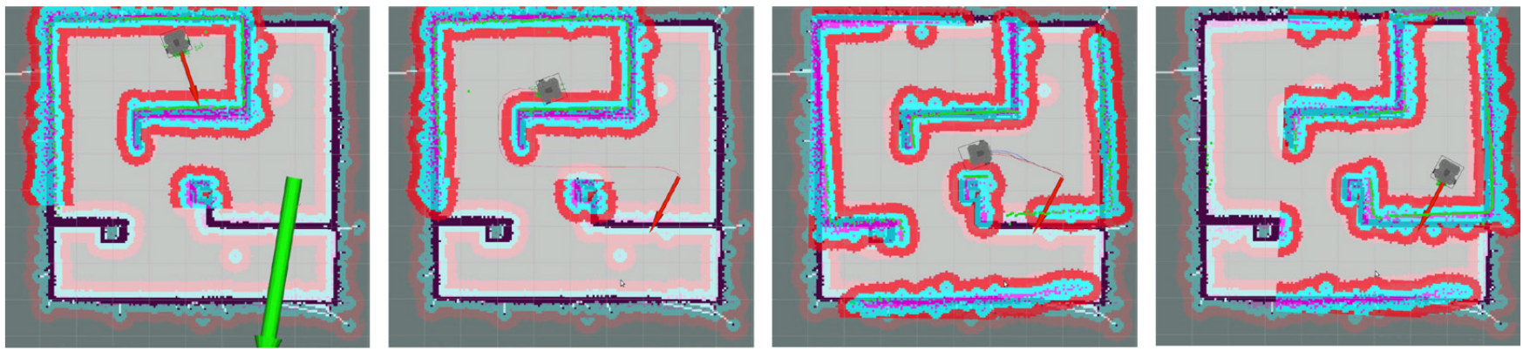
Set Navigation Goal and Tuning Guide
Click the 2D Nav Goal button in the RViz menu.
Click on the map to set the destination of the robot and drag the green arrow toward the direction where the robot will be facing.
This green arrow is marker that can specify the destination of the robot
The root of the arrow is x, y coordinate of the destinationm and the angel θ is determined by the orientation of the arrow.
As soon as x, y, θ are set, TurtleBot3 will start moving to the destination immediately.
* Navigation Example
School of Global Convergence Studies

Slide 11
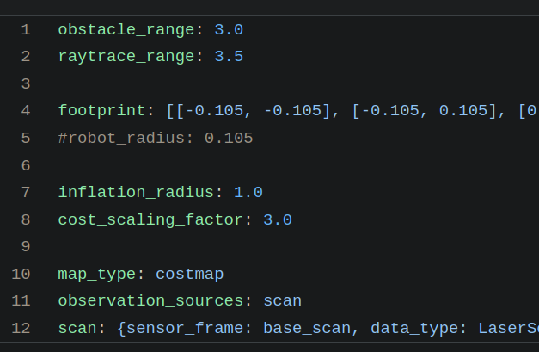
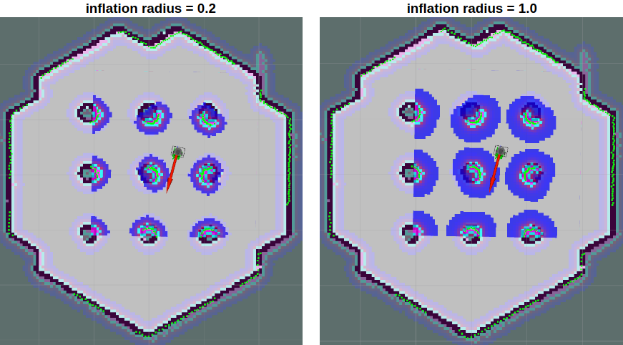
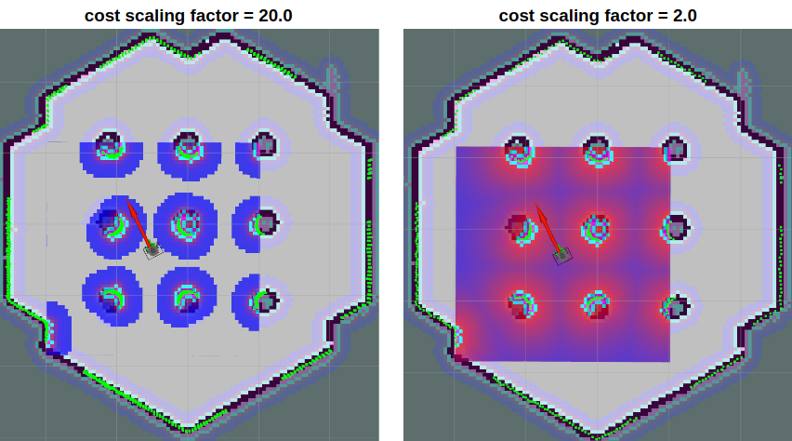
Set Navigation Goal and Tuning Guide
turtlebot3_navigation/param/costmap_common_param_burger.yaml
infilation_radius – makes inflation area from the obstacle. Path would be planned in order that it does not across this area. It is safe that to set this to be bigger that robot radius.
cost_scaling_factor – is multiplied by cost value. Because it is an reciprocal propotion, this parameter is increased, the cost is decreased.
School of Global Convergence Studies

Slide 12
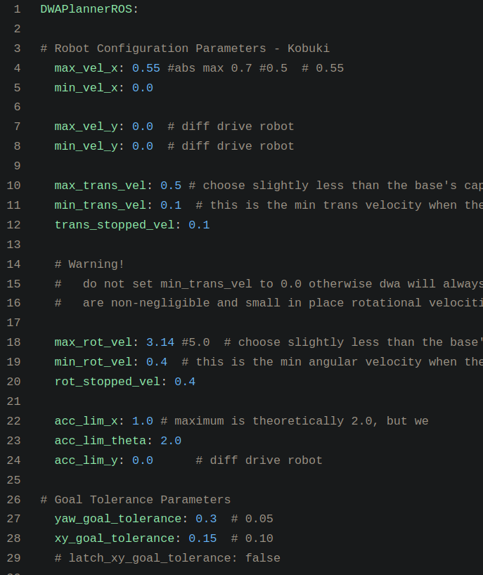
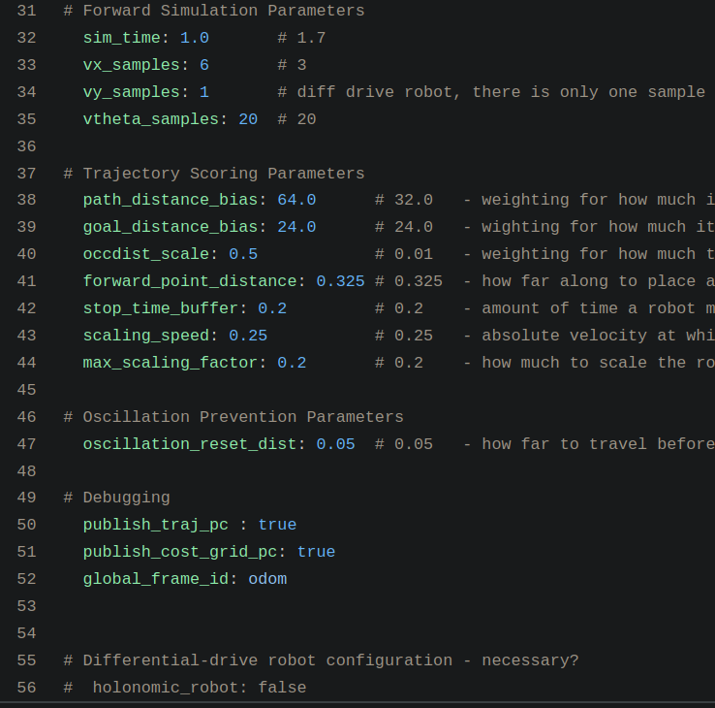
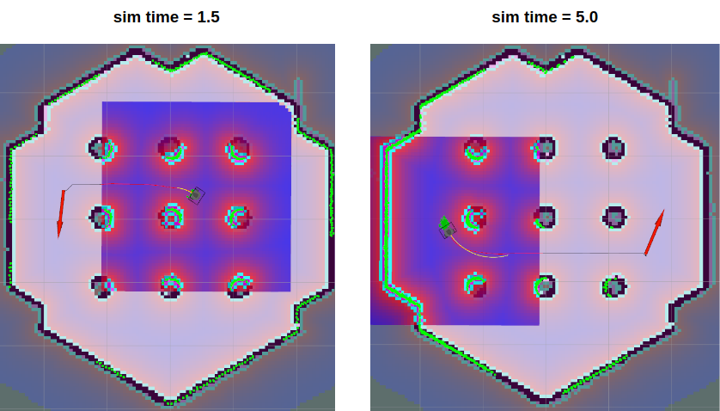
Set Navigation Goal and Tuning Guide
max_vel_x – is set the maximum value of the translation velocity.
min_vel_x – is set the minimum value of the translation velocity.
* If set this negative, the robot can move backward.
max_trans_vel – is action value of the maximum translation velocity.
* The robot cannot be faster than this
min_trans_vel – is action value of the minimum translation velocity.
* The robot cannot be slower than this
max_rot_vel – is action value of the maximum rotational velocity.
* The robot cannot be faster than this
min_rot_vel – is action value of the minimum rotational velocity.
* The robot cannot be slower than this
acc_lim_x – is action value of the translational acceleration limit.
acc_lim_theta – is action value of the rotational acceleration limit.
xy_goal_tolerance – the x, y distance allowd when the robot reaches its goal pose.
yaw_goal_tolerance – the yaw angle allowed when the robot reaches its goal pose.
turtlebot3_navigation/param/dwa_local_planner_params.yaml
sim_time – is set forward simulation in seconds. Too low value is in sufficient time to pass narrow area and too high value is not allowed rapidly rotates. You can watch differences of length of the yellow line in below image
School of Global Convergence Studies

